Slide 1


Orientation to Fieldwork
Guidance for students in the School Counseling program

Slide 2

AGENDA
Fieldwork/requirements
Pre-Fieldwork
Fieldwork Fair
Advancing to Fieldwork

Slide 3

What is fieldwork?
Indirect/Direct experiences
One on one
Group settings
Activities dependent on setting
Notes:
Individual counseling, Group counseling (co-facilitating or leading), Academic advising, Conflict resolution, Career counseling, Classroom lessons
Leading multidisciplinary meetings (parent conferences, community collaboration, cross-departmental collaboration, FAFSA night, etc.)
Providing referrals/resources in-person or via telephone directly to students, caregivers, or families
Crisis intervention and/or assessment, In-service presentations, Conducting assessments/tests, Leading a webinar, Consultation
Indirect experiences might be research and preparation for sessions with counselees, group planning, Observing multidisciplinary meetings
Observing multidisciplinary meetings (IEP/Disability Services meetings, 504, SST’s, parent/caregiver conferences, cross-departmental collaboration, mediation, etc.)
Writing case notes, Professional development specific to school counseling (trainings, conferences, in-service, etc.), Event planning for site specific events (career fair, college fair, FAFSA night, graduation, student engagement events, etc.), Supervision, Attending faculty meetings, Developing crisis protocol, Planning in-service trainings
Administrative tasks (emails, phone calls, clerical duties)

Slide 4
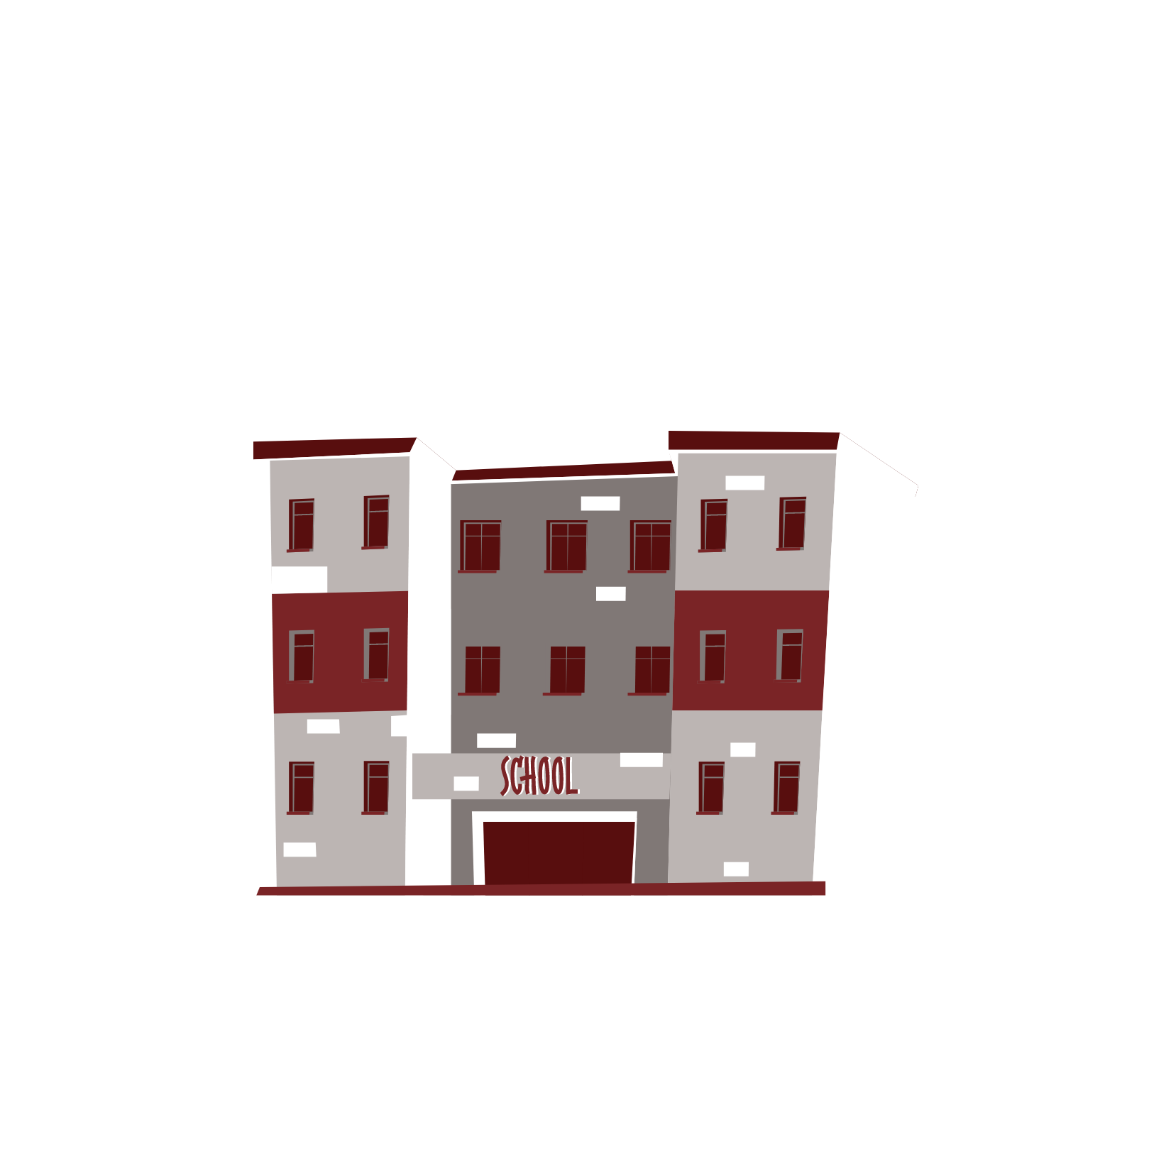


FIELDWORK REQUIREMENTS
  800 Total Fieldwork Hours
    600 hours in Pre-K-12 public schools
    Minimum 2 of 3 Pre-K-12 Settings
    200 “choice” hours
PRE-K-12
  600 Total Fieldwork Hours
    400 hours at a community college or university
    Minimum of 2 Sites (can be same institution)
    200 hours recommended at high school to college transition setting
COLLEGE
  800 Total Fieldwork Hours
    600 hours in Pre-K-12 public schools
    Minimum 2 of 3 Pre-K-12 Settings
    200 hours at community college or university setting
COMBO
Notes:
The required number of fieldwork hours varies by catalog year and by emphasis.
In all instances, a set amount of the hours must be direct and there are a minimum number of settings required.
Combo emphasis: A minimum of eight hundred (800) clock hours are required in public school settings at two of three school levels such as elementary, middle, high school with a minimum of two hundred (200) clock hours at each level. Two hundred (200) of the eight hundred (800) clock hours must be in a college or a high school-to-college transition setting. At least six hundred (600) clock hours must be completed in public school settings with Pre-K-12 pupils. As part of the required fieldwork hours, candidates that started their program in Fall 2021 must complete at least 100 hours of field experience in each of the following areas: Social/Emotional, College/Career, and Academic.
All candidates must ensure one hundred fifty (150) of their clock hours are devoted to issues of diversity. Hours may be satisfied by working with counselees of diverse backgrounds including socioeconomic disadvantaged, linguistically diverse, counselees who are housing insecure, counselees who are former foster youth; counselees with disabilities, counselees experiencing issues related to academics or misconduct, counselees who identify as LGBTQ+, counselees who hold historically minoritized racial and ethnic identities; and understand the impact of institutional, local, state, and federal policies for counselees of diverse backgrounds. Candidates track their diversity hour requirement via Time2Track.

Slide 5
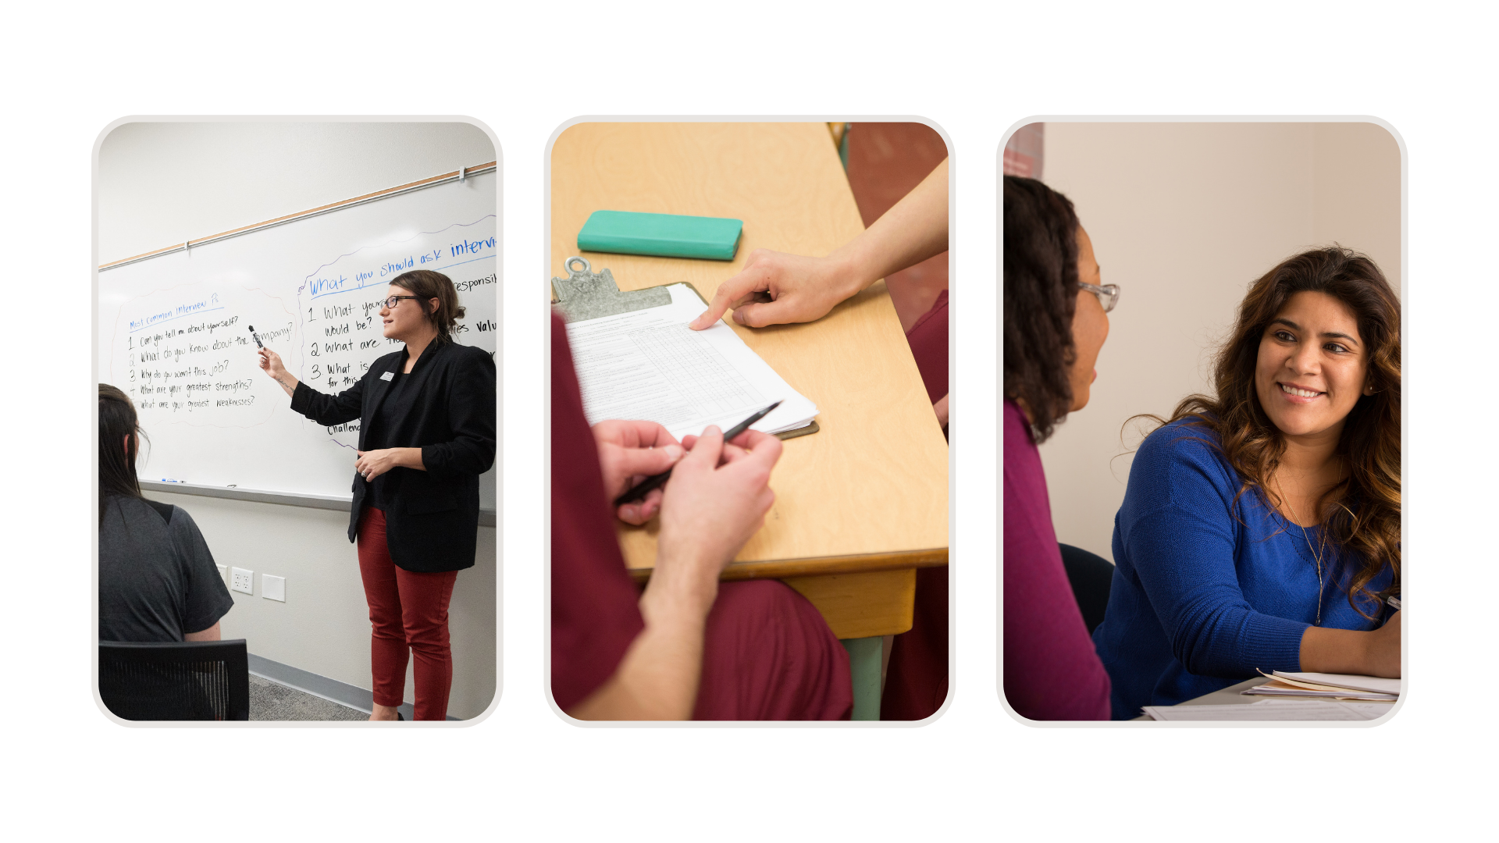
Preparing for Fieldwork
PRACTICA
FIELDWORK FAIR
ADVANCING TO FIELDWORK
Notes:
Practica Hours
Purpose -100 (80/20)
First 2 terms/prof orgs/people doing the work
Examples: shadowing counselor, school board meeting, OCPD services, group advising, fieldwork fair, prof org webinar/conference, outlined in handbook, if unsure contact Dr. Ai
Timeline – due before advance to field
Fieldwork Fair
Spring 2024
Purpose/Components
Preparation/Resources (self-reflection/Grp advising)
Registration
Advancing to Fieldwork
Choice
Spaces /3 domains
Levels
Deadlines fw placement request
Group advising
Promote college-level opps

Slide 6
PRE-FIELDWORK
Fall term
Review 2023 fieldwork handbook
  Submit acknowledgement of receipt form via Etrieve
Join a professional organization (or two) that aligns with your interests
  American Counseling Association (ACA)
  American School Counseling Association (ASCA)
Transition your resume to a Curriculum Vitae (CV)
  Standard in the counseling field is a CV
  Office of Career and Professional Development (OCPD) can assist
Conduct (indirect) practica hours/Track via log
  Shadow a counselor
  Attend a district meeting
  Watch a webinar that aligns with one of the School Counseling domains
Notes:
Learn about the industry, professions, and yourself!
Making intentional choices
Join a professional organization
Network
Seek out practica experiences that support your interests

Slide 7
PRACTICA REQUIREMENTS
Course | Activity | Hours
EDUC 601 The Counseling Process | Peer-to-peer counseling and Self-Assessment of Skills | 25
EDUC 685 Foundations of School Counseling | Informational interview | 10
EDUC 653 Theories of Counseling and Psychotherapy | Case conceptualizations | 15
CMHC 610 Sociocultural Counseling and Interventions | Case conceptualizations | 15
CMHC 692 Crisis Intervention Counseling | Case conceptualizations | 15
Total |  | 80
80 Hours in the First Three Terms
100
HOURS
20
Choice
Hours
Notes:
The remaining 20 hours are the candidate’s choice. Activities that qualify include, but are not limited to, attending workshops or conferences, observing school-based meetings, and assignments in academic courses. The number of hours for each activity will vary according to the length of the activity. When determining how to earn the remaining 20 hours, candidates are expected to choose activities that foster their academic, career, and/or social emotional development.

Slide 8
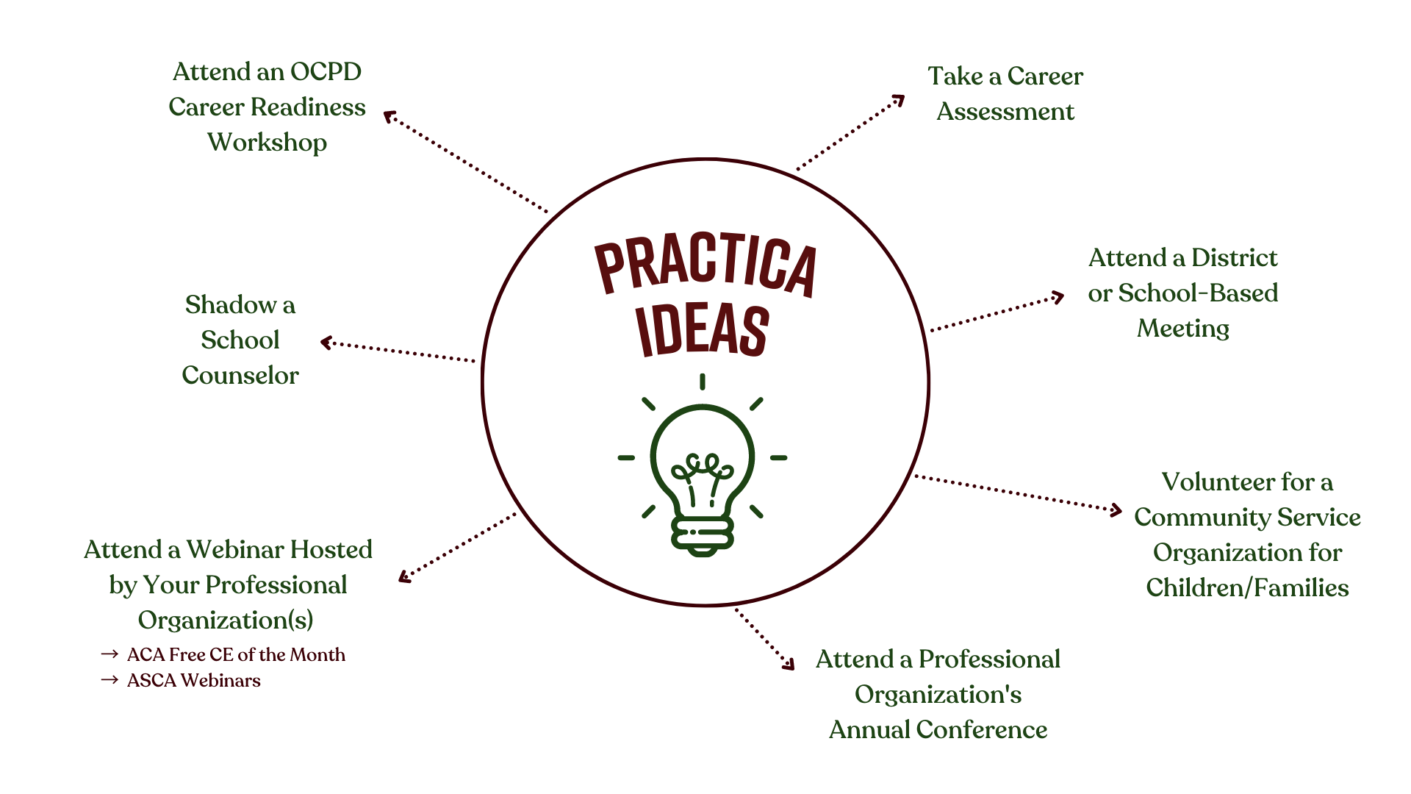
Notes:
Examples of possible experiences that count toward these remaining 20 hours of experiences, including University of Redlands (UofR) affiliated experiences and experiences not affiliated with the UofR. Candidates are prohibited from engaging in activities during practica that would be considered direct, meaning candidates are not to conduct assessments, provide individual or group counseling, etc. as they are not yet assigned to a site and/or under supervision by a site supervisor. For ethical reasons and to ensure adequate preparation, candidates will only conduct indirect activities prior to advancing to fieldwork.
Candidates will track the remaining 20 practica hours using the Practica Log Sheet available via the School Counseling Current Student Webpage. Candidates are responsible to submit their practica hours for verification and approval by the School Counseling Program Coordinator (Dr. Yang Ai). All practica hours must be completed and the log sheet completed, signed by the candidate, signed by the program coordinator, and submitted before advancing to fieldwork. The approved practica log is uploaded as part of the Fieldwork Placement Form. Refer to Appendix B for fieldwork deadlines.

Slide 9
FIELDWORK FAIR
Spring term
Get to know our Fieldwork Partners
  Attend Fieldwork Partner Fair
  Pre-Fair Group Advising
Explore sites and levels
  Network to learn about districts
  Visit district/school websites
  Seek out college and community settings
Notes:
Hear from faculty, alumni, 2nd year students and community partners

Slide 10

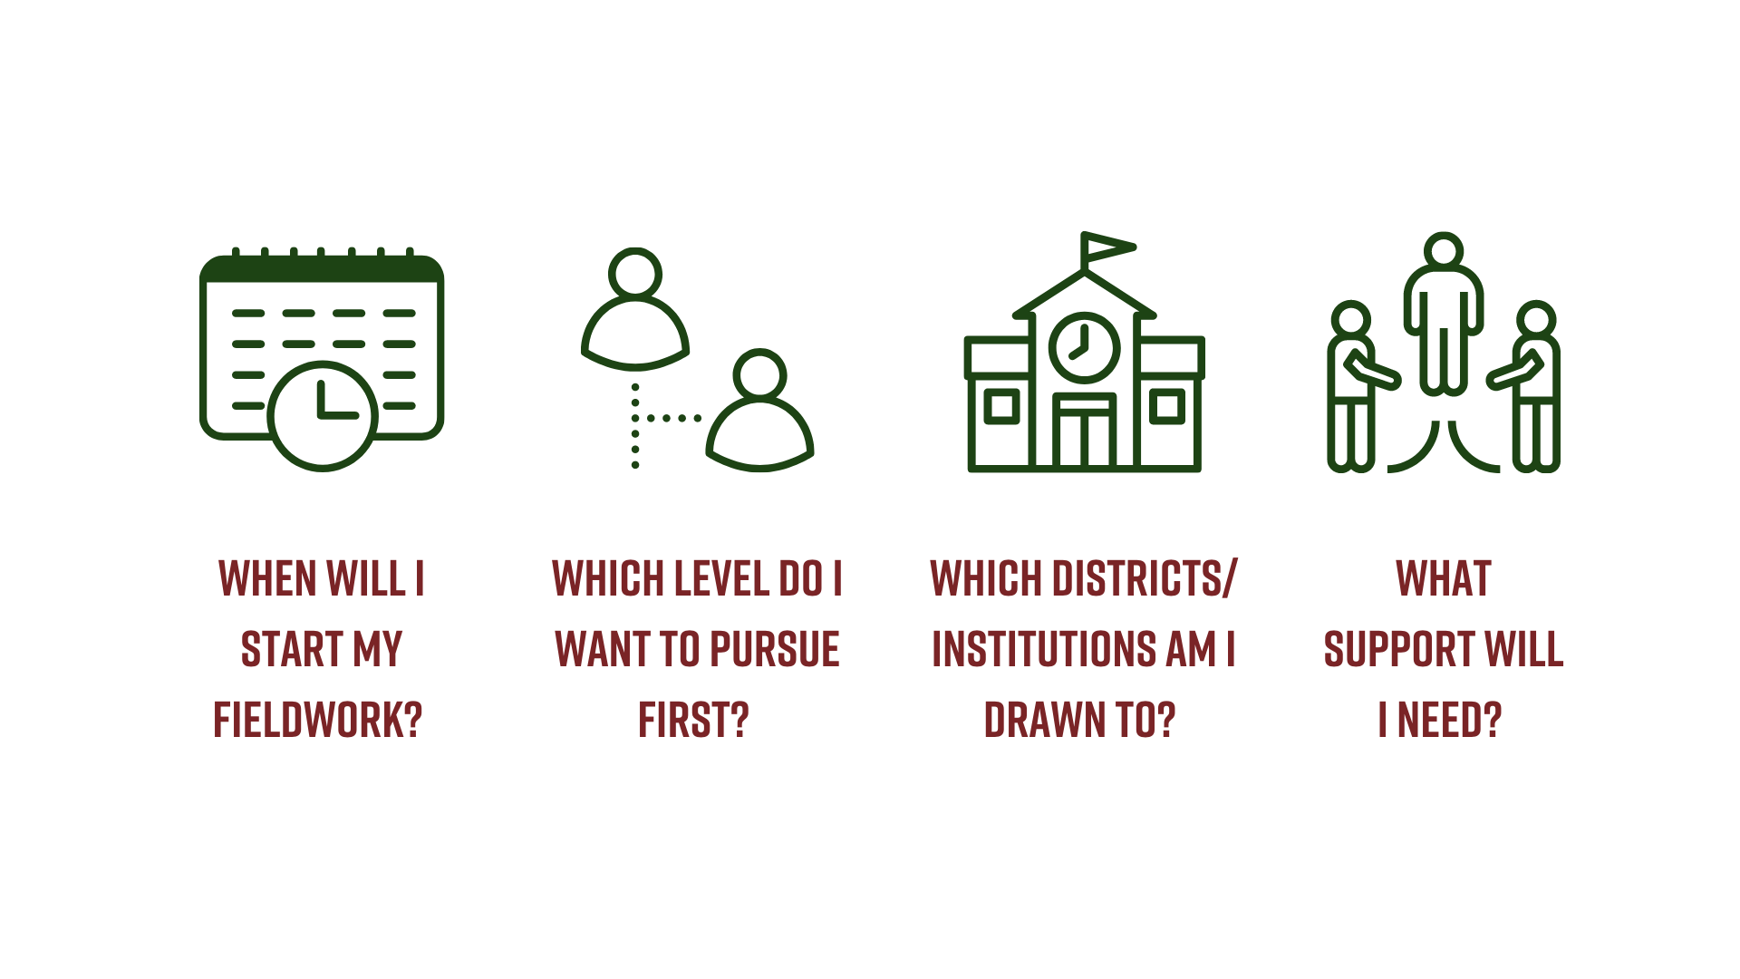
ADVANCING TO FIELDWORK
Notes:
When will I start my fieldwork?
Which level do I want to pursue first?
Which districts/institutions are you drawn to?
What support will you need?

Slide 11

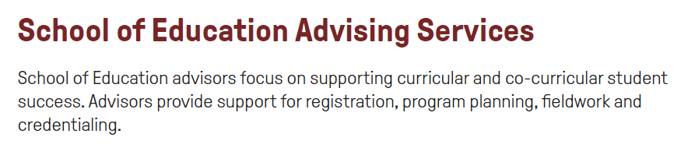
QUESTIONS
Have questions about the fieldwork component of your program?
Book an individual appointment

